Slide 1
Citrusleaf
Citrusleaf
A Real-Time NoSQL DB That Preserves ACID
Srini V. Srinivasan
Brian Bulkowski

Slide 2
Citrusleaf
The real-time NoSQL database company
  Reliable, Scalable, Exceptionally fast
  Immediate consistency (ACID compliant)
Founded 2009
Citrusleaf V2.0 (in production since Sept. 2010)
  200K+ TPS per node
  Low latency
  Runs on commodity h/w
  24x7 uptime
  Several Web scale deployments
Citrusleaf RTA (in production since July 2011)

Slide 3
High velocity user data
Applications
  Real-time bidding applications
    Cookie matching
    Server side user profiles
    Frequency capping
  Online & social game data
    Retrieval of select user histories in seconds
    User ID storage & access
  High Traffic Web Sites
    Session Management
DB Requirements
  High write/read ratio (e.g. 70% reads, 30% writes)
  Need access to recent data
  Need low latency (milliseconds)

Slide 4
Real-time matching
Users - 500 Million
Joe | Smith | Toronto
Kevin | Lyon | San Jose
Lisa | Jing | New York
Mike | Nolan | Detroit
Ashwin | Iyer | Chicago
. | . | .
. | . | .
. | . | .
. | . | .
. | . | .
. | . | .
. | . | .
. | . | .
Citrusleaf Application
Citrusleaf Database
500M+ Objects 100K+ operations/second 100% uptime
Flexible scaling Low latency (< 1ms) Self Management

Slide 5
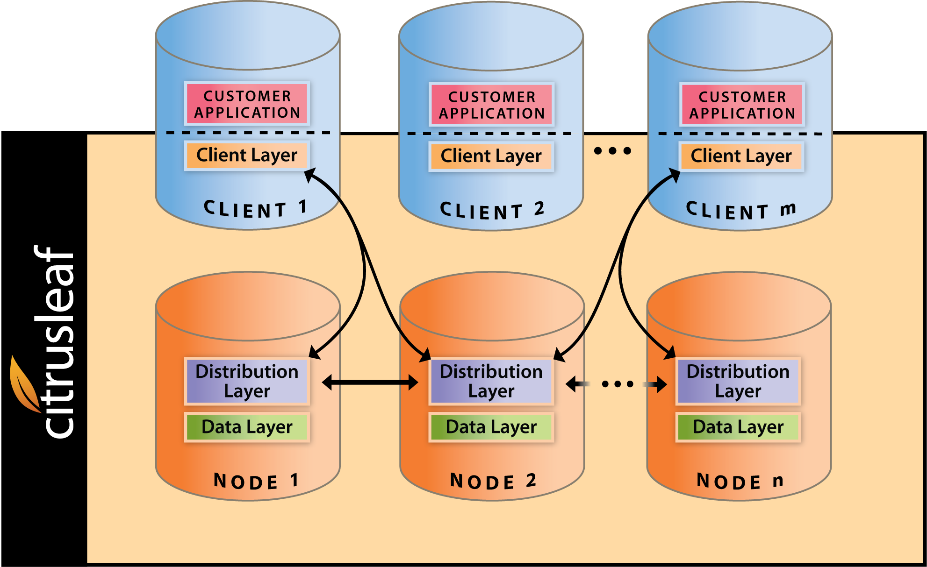
Citrusleaf 2.0
Combination of OLTP & distributed technology
Architecture
  Client Layer
  Distribution Layer
  Data Layer
Linear scale-out algorithms

Slide 6
Transactions, short and long
Short transactions with Immediate Consistency
  Writes applied synchronously to all copies
Long running data rebalancing tasks
  Prioritized lower than short transactions
24X7 uptime considerations
  Relax availability for brief periods to maintain consistency
  Relax consistency during partitions to maintain availability

Slide 7
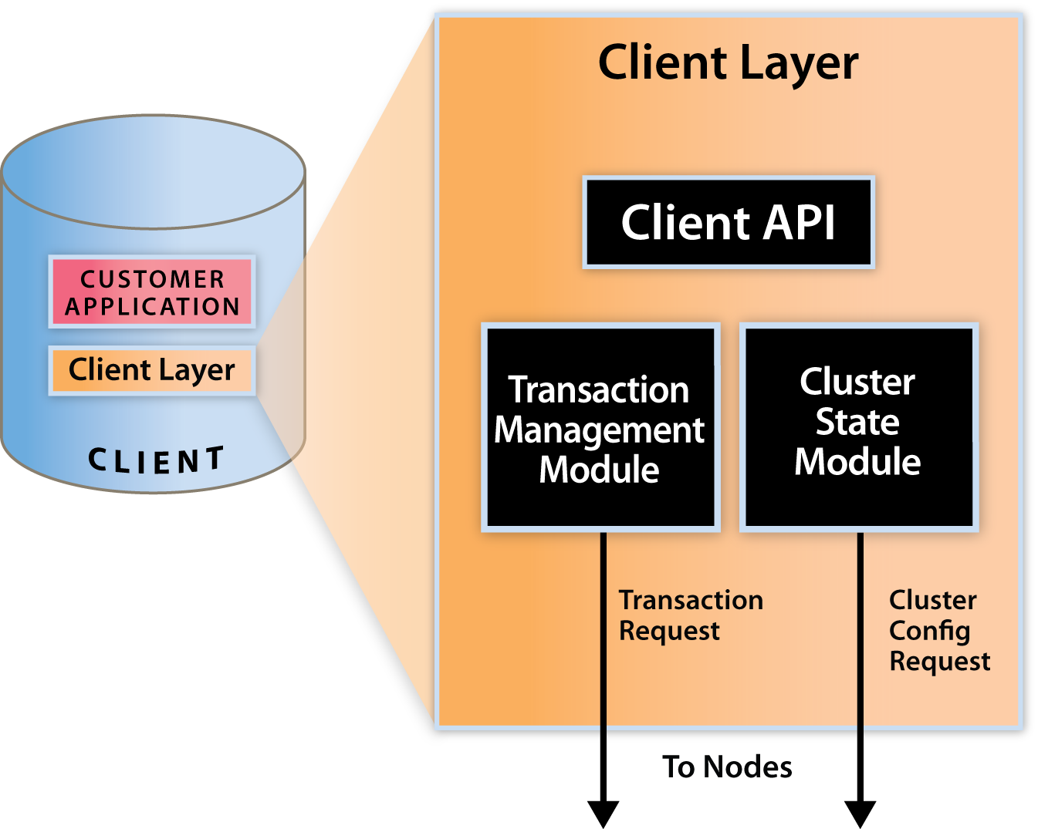
Client layer
Parallel query optimization
Client cluster knowledge
  Non-stop transactions
  Efficient transaction routing; higher speed
Source-code available plugs easily into custom application environments

Slide 8
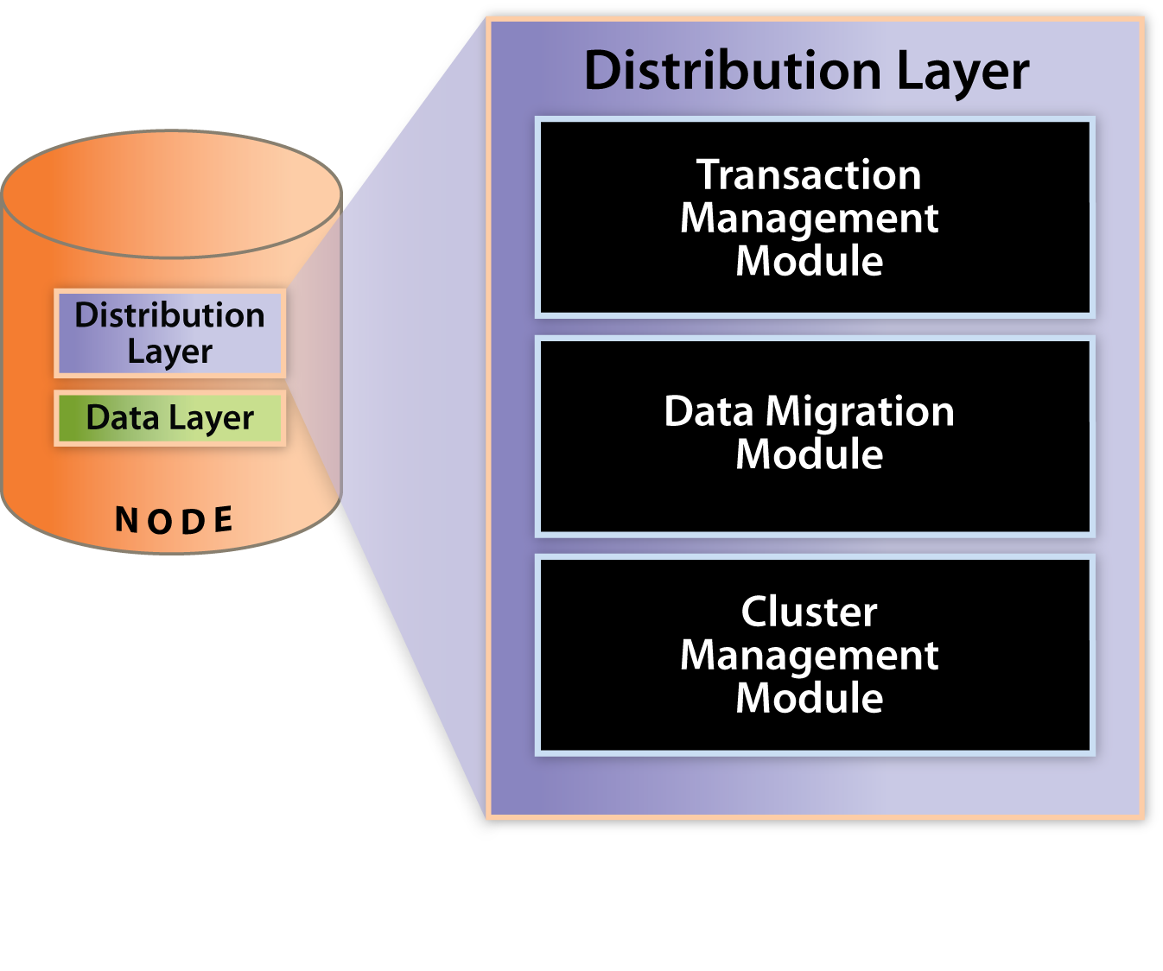
Distribution layer
Shared nothing
Automatic load & data balancing
Distributed transaction commit
Tunable consistency
Low-overhead consensus

Slide 9
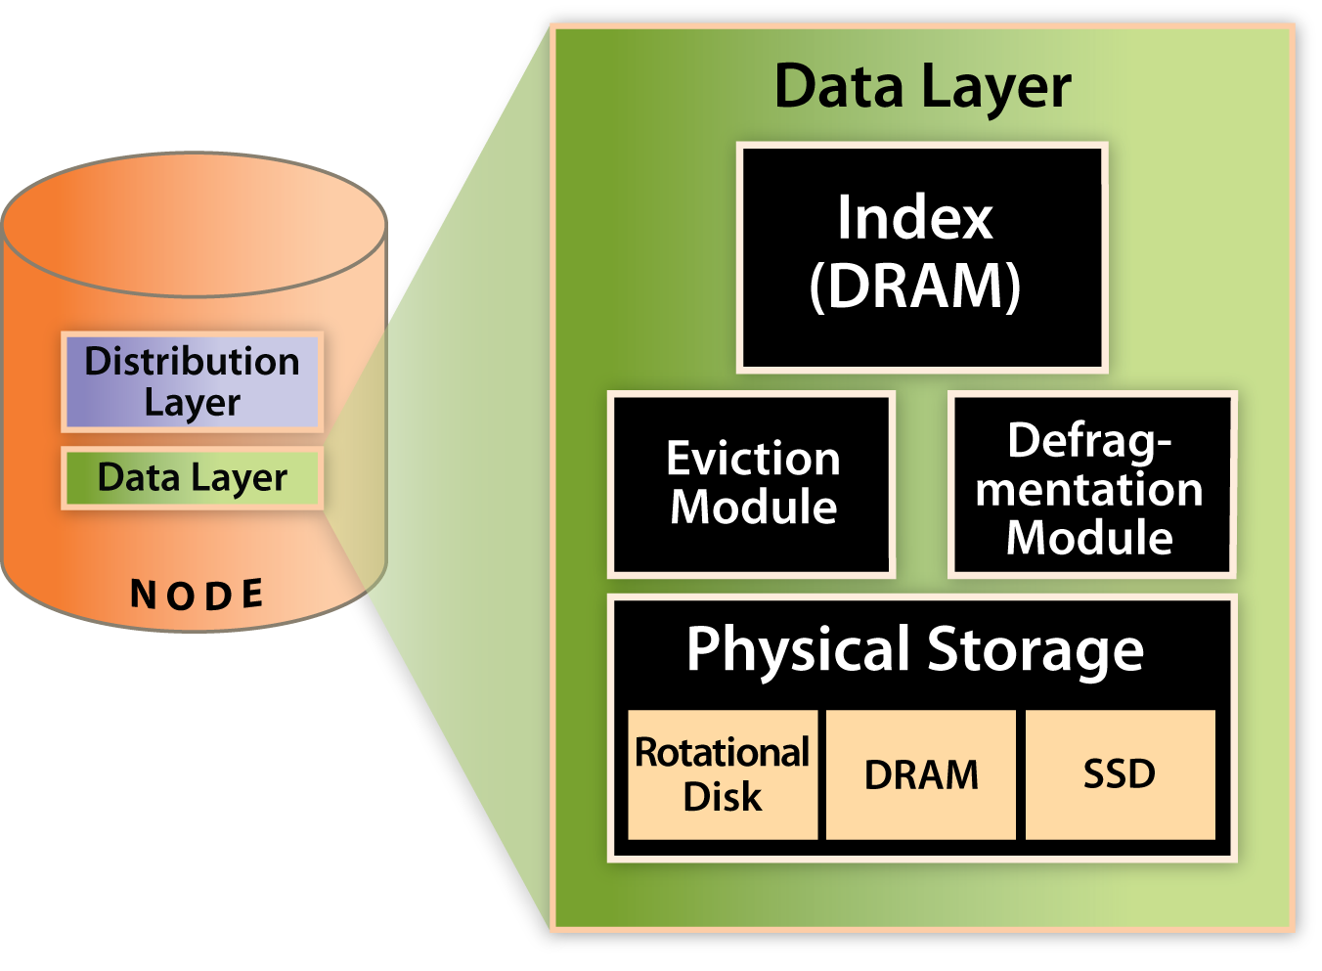
Data layer
Optimized for cost-effective hardware combinations
  DRAM and rotational
  SSD
  High capacity rotational indexes
Real-time eviction
  Integration with warehousing solutions

Slide 10
Technology
Distributed Index techniques for performance
  Multi-level concurrency control ending in a record lock
  Fast snapshots based using mark and sweep
Schema free data API
  Dynamically extensible data types
  Multi-language support: C, PHP, Java, Python, Ruby, …
Self-management
  Ease of upgrading

Slide 11
Example Use Case
Major Real-Time Advertisement Company
  Applications:
    User Profile Store
    Real Time Bidding Infrastructure
  Environment
    > 50 servers
    3 data centers worldwide
    24 x 7 uptime (100% available)
    Commodity hardware
    Full support for SSD and DRAM/HDD storage
  Fast deployment (4-8 weeks)

Slide 12
Benchmarks
Setup
  2-4 node clusters
  2 copies of data in cluster
  Immediate consistency
  Commodity nodes
Results
  Linear scale up
  Over 200,000 tps per node
  Sub-millisecond latency

Slide 13
Future Directions
Cross data center replication
Real-time analytics/reporting
Multi-record transactions
Graph APIs
SQL support
. . .

Slide 14
Summary
Unique set of functionality
  Immediately consistent
  Self-managing clusters
  High performance: 200K+ TPS per node, low latency (sub millisecond)
  Support for billions of objects & high volumes of transaction data
  Flexible data storage (DRAM, SSD & Rotational Disk)
High ROI
  Low TCO: 2 to 5X less expensive hardware setup cost
  Fast deployment (a matter of weeks)
  Highly available and self-sustaining

Slide 15
Questions
www.citrusleaf.com
VLDB, 09/01/11

