Slide 1
Distributed Inference and Query Processing for RFID Tracking and Monitoring
  Zhao Cao*, Charles Sutton⁺, Yanlei Diao*,
  Prashant Shenoy*
  *University of Massachusetts, Amherst
  ⁺University of Edinburgh

Slide 2
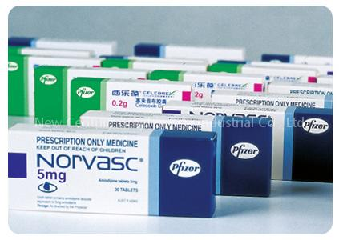
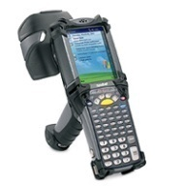


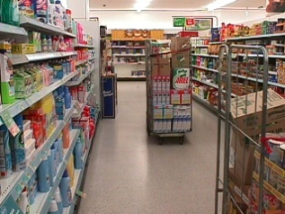
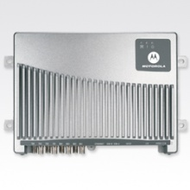

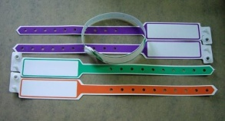
Applications of RFID Technology
RFID readers

Slide 3
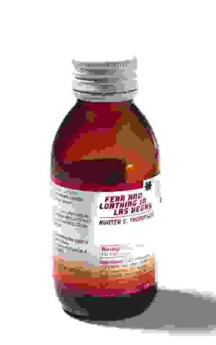
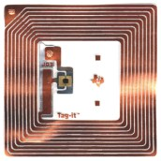
RFID Deployment on a Global Scale
+
Tag id: 01.001298.6EF.0A
Reader id: 5140
Time: 2008-02-10, 12:40:00
Tag id: 01.001298.6EF.0A
Reader id: 5140
Time: 2008-01-21 08:15:00
Tag id: 01.001298.6EF.0A
Reader id: 6647
Time: 2008-01-30 15:00:00
Tag id: 01.001298.6EF.0A
Time: 2008-01-12, 14:30:00
Manufacturer: X Ltd.
Expiration date: Oct 2011
Tag id: 01.001298.6EF.0A
Reader id: 7990
Time: 2008-02-04, 09:10:00
Tag id: 01.001298.6EF.0A
Reader id: 3478
Time: 2008-01-15, 06:10:00

Slide 4
Tracking and Monitoring Queries
Path Queries:
List the path taken by an item through the supply chain.
Report if a pallet has deviated from its intended path.
Object locations
and history
Containment Queries:
Alert if a flammable item is not packed in a fireproof case.
Verify that food containing peanuts is never exposed to other food cases.
Containment among items, cases, pallets
Hybrid Queries:
For any frozen food placed outside a cooling box, alert if it has been exposed to room temperature for 6 hours.
Sensor data
Location Containment

Slide 5
Challenges in RFID Data Stream Processing
Q1: For any frozen food placed outside a cooling box, raise an alert if it has been exposed to room temperature for 6 hours.
Sensor Stream
(time, location, temperature)
RFID Stream
(time, tag_id, reader_id)
1. RFID data streams are not queriable (no location or containment info).
2. RFID Data is incomplete and noisy.
3. Scale inference and query processing to numerous sites and millions of objects.
1
2
1
2
Missing
Overlapped
3
4
5
6
3
4
4
5
6
Locations:
F
E
D
F
E
D

Slide 6
A Scalable, Distributed RFID Stream Processing System
Monitoring result
(time, tag_id, query result)
Distributed Query Processing
Queriable RFID Stream
(time, tag_id, location, container)
Distributed Loc. & Cont. Inference
Location & Containment Inference
Raw RFID Stream
(time, tag_id, reader_id)

Slide 7
I. Location and Containment Inference – Intuition
Time t=1
t=2
t=3
t=4
Cases
1
2
1
2
1
2
1
2
Items
3
4
5
6
3
4
5
6
3
4
5
6
3
4
5
6
Reader location: A
B
C
D
E
C
F
E
D
Containment Inference:
Co-location history
Iterative
procedure
Location Inference:
Smoothing over containment
Item 5 is contained in case 2
Case 2 is in Location C at t=3
Item 6 is contained in case 2
Containment Changes: Change point detection
Containment between case 1 and item 4 has changed

Slide 8





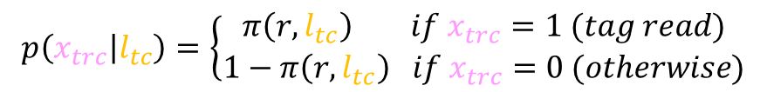
(1) Our Probabilistic Graphical Model
T
Hidden variables : true object and container locations
Sensor model
C
$$l_{c}$$
R
$$x_{c}$$
Containment
(0 or 1)
Containment: edges between hidden variables
Evidence variables: RFID readings
$$l_{o}$$
Sensor model
R
RFID sensor model: read rate, overlap rate
$$y_{o}$$
Independency assumptions:
  Independence among containers
  Independence over time
Read rate: $π\left(r,l_{tc}\right)$, sampled and updated periodically
RFID sensor model:
$$p\left(x_{trc} | l_{tc}\right)=\left\{\begin{aligned}π\left(r,l_{tc}\right) if x_{trc}=1 (tag read) \\ 1−π\left(r,l_{tc}\right) if x_{trc}=0 (otherwise)\end{aligned}\right.$$
Joint probability:

Slide 9
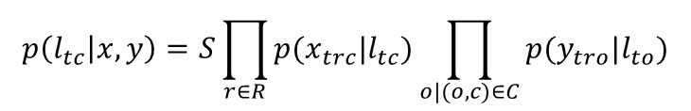
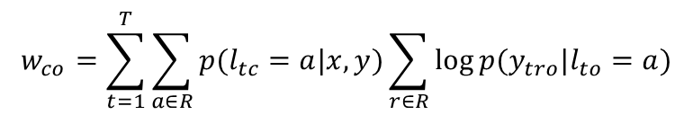

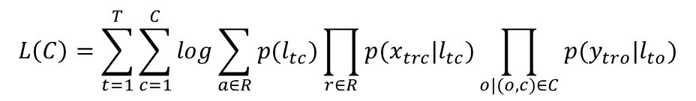
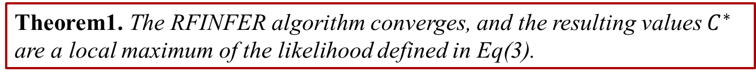
(2) Location and Containment Inference using EM
Log likelihood
$$L\left(C\right)=\sum_{t=1}^{T}{\sum_{c=1}^{C}{log\sum_{a∈R}{p(l_{tc})\prod_{r∈R}{p(x_{trc}|l_{tc})\prod_{o|(o,c)∈C}{p(y_{tro}|l_{to})}}}}}$$
Function of containment C
An iterative algorithm in the EM framework:
Posterior of each container’s location
  E-Step:
Current guess about the containment relations
  M-Step:
  (customized)
Posterior of each container’s location
Choose the best containment relation
Until the containment relations don’t change
Final values of $p\left(l_{tc} | x,y\right)$ are used to determine the location of container and objects
Theorem1. The RFINFER algorithm converges, and the resulting values $C^{∗}$ are a local maximum of the likelihood defined in Eq(3).
.
Notes:
To infer containment relationships from RFID readings,
we use a maximum likelihood framework, that is,
we determine the containment relationships such that, according to the model, the observed readings are most likely.
Note that the likelihood is a function of the containment relationships C.
To emphasize this, we define L(C) = log p(x; y).
To get the best parameter for this log likelihood, EM framework is employed here,
which offers a general approach for maximizing likelihood functions in the presence of missing data,
in our case the container locations.
The algorithm alternates between two steps.
In the first step, the expectation step (or E-step),
we infer a distribution over the locations of each container, given some current guess about the containment relations.
In the second step, the maximization step (or M-step), we choose the best containment relations given our current guess of the container locations.
We iterate these two steps until the containment relations do not change.
In the E-step, the distribution that we want to compute is the conditional distribution p(l|x, y) over the location of each container
that results from the joint distribution.
this distribution is called the posterior distribution of the container location.
In the M-step, we update the current estimates of containment relationships based on the current belief about locations.
We do so by defining a score wco to measure the strength of co-location between object o and container c.
This score measures how likely are the readings of object o if it were always co-located with container c.
To estimate the container for o, we simply pick the best container.
The RFINFER algorithm converges, and the resulting values $C^{∗}$ are a local maximum of the likelihood defined in Eq(3).
The key step is to show that our simple, custom M-step indeed maximizes the likelihood. For more detail about the proof, please refer the paper.

Slide 10
(3) Change Point Detection -- Intuition
Time t=1
t=2
t=3
t=4
Cases
1
2
1
2
1
2
1
2
Items
3
4
5
6
3
4
5
6
3
4
5
6
3
4
5
6
Reader location: A
B
C
D
E
C
F
E
D
A statistical approach based on hypothesis testing
  Null hypothesis: no containment change in [0, T].
  Alternative hypothesis: containment change at time t’, 0 ≤ t’ ≤ T.
  If Δ is over a threshold δ, a change; otherwise, no change.
  δ is obtained by offline sampling hypothetical observation sequences from the model with stable containment (e.g., using the max likelihood).

Slide 11




(5) Implementation and Optimizations
Both E-step and M-step have high complexity O(TCOR²)
O(TCOR²)
Optimizations:
  Location restriction: each object is read in a few locations
  Containment restriction: a container includes a small set of objects
  Candidate pruning: for an object, consider only containers observed frequently in the first few epochs and in several recent epochs
O(TC+TO)
  History truncation: further eliminate the factor of T
O(C+O)
  Memoization: reuse values from the previous iteration of EM
T
    Inference is run every few seconds
    Change point detection:
      Runs at the end of each inference
      Sums up quantities memorized in inference, little extra overhead
Sensor model
C
R
Containment
(0 or 1)
Sensor model
R
Notes:
According to the RFInfer algorithm, both the E-step and M-step have the complexity of $O(TCOR^{2})$
We employed a set of optimizations:
The first is using location and container constraints.
As each object is typically read in only a small number of locations and each container contains a small number of items,
Both of those are bounded independently of R and O, the E-step can be improved by a factor of OR square,
so the E-step requires only O(TC) time.
Regarding the M-step,
it can be easily improved by a factor of R square again because each object is typically read in only a small number of locations.
So M-step requires $O(TCO)$ now
The second optimization is Candidate pruning
when computing the container that is most strongly co-located with a given object, it is probably safe to consider only containers that
have been observed frequently with the object. We can eliminate the factor of C, M-step requires $O\left(TO\right)$
The third optimization is using Memorization
If the set of objects in a container did not change in the previous EM iteration, then location probabilities and co-location strengths for that container cannot change in current iteration. The old value is reused to avoid unnecessary computation
The fourth optimization is history truncation
Truncate the history of size $T$ to a small critical region whose size is independent of T
Eliminate the factor of T,
Finally: E-step requires $O(C)$, M-step requires $O(O)$ of time
Change point detection is simply the sum of the point evidence memorized from RFINFER algorithm, incurs little extra overhead

Slide 12
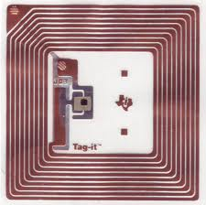
II. Distributed Processing with State migration
Query processing
Global Proc.
State migration
Local Proc.
State migration
Object events
(tag,loc,cont,…)
Sensor readings
Inference
RFID readings
(tag,reader,time)
Site1
Site 3
Site 2
SELECT tag_id, A[].temp
FROM ( SELECT RSTREAM(R.tag_id, R.loc, T.temp)
FROM RFIDStream [NOW] as R,
TempStream [PARTITION BY sensor_id ROW 1] AS T
WHERE (R.container != ‘cooling box’ or R.container = NULL) and
R.loc = T.loc and T.temp > 10°C
) AS Global Stream S
[ PATTERN SEQ(A+)
WHERE A[i].tag_id = A[1].tag_id and A[A.len].time > A[1].time+6 hrs ]
Local Processing
Global Processing
Query: Raise an alert if a frozen product has been placed outside a cooling box for 6 hours.

Slide 13
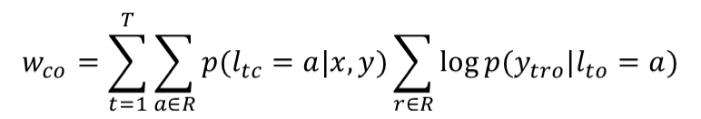
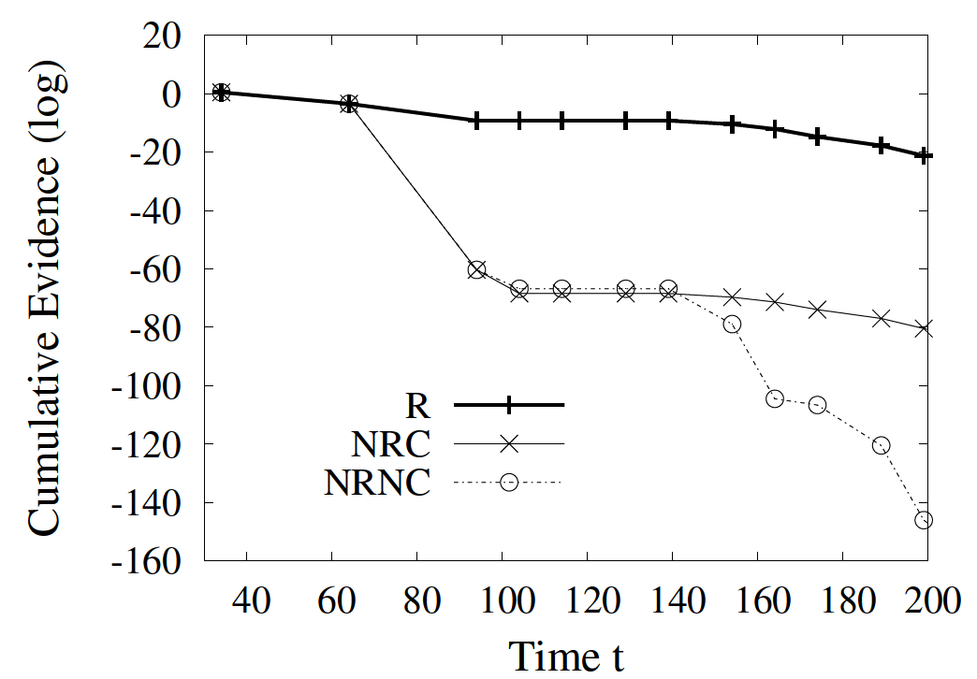
Minimize Inference State – History Truncation
t=0~90
t=100~105
Time
t=120~200
Strength of co-location in M-Step in inference:
Entry
door
Belt
Shelf A
R
NRC
Shelf B
NRNC
Periodically find a critical region, CR, over history.
Later inference runs on (CR + recent history H’).
When an object leaves a site, compress CR to a single weight (co-location strength) to minimize state.

Slide 14

Minimize Query Processing State via Sharing
Global query processing
  A query state for each object
  As an object leaves a site, transfer the query state to the next
Query state for each object: e.g.,
  Current automaton state
  Values for future predicate evaluation in automaton execution
  Values that the query returns
SELECT tag_id, A[].temp
FROM ( …
) AS Global Stream S
[ PATTERN SEQ(A+)
WHERE A[i].tag_id = A[1].tag_id and A[A.len].time > A[1].time+6 hrs ]
Volume: kilobytes or more per object per query

Slide 15
Minimize Query Processing State via Sharing
Global query processing
  A query state per object per query
  As an object leaves a site, transfer the query state to the next
Sharing query states based on stable containment
  At the exit, objects in a container have the same location and container (but possibly different histories)
  Share their query states using a centroid-based method
    Find the most representative query state
    Compress other similar query states by storing only the differences
Query states before compression
Query states after compression
[1,2,3,4…]

Slide 16

Implementation and Evaluation
Implemented inference, distributed inference, and distributed query processing
Instrumented an RFID lab in a warehouse setting
Developed a simulator for a network of warehouses
Number of warehouses (N): 1-10
Frequency of pallet injection: 1 every 60 seconds
Cases per pallet: 5
Items per case: 20
Main read rate of readers (RR): [0.6,1], default 0.8
Overlap rate for shelf readers (OR): [0.2,0.8], default 0.5
Non-shelf reader frequency: 1 every second
Shelf reader frequency: 1 every 10 seconds
Frequency of anomalies (FA): 1 every 10 to 120 seconds

Slide 17
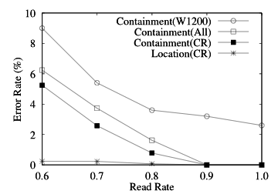
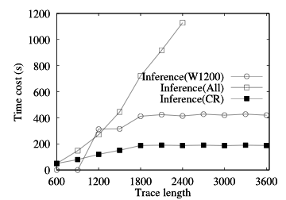
Single Site, Stable Containment
Three methods: history truncation (CR), simple windowing (W), naïve (all history)
Metrics: accuracy of location and containment inference, time cost of inference
All three methods offer high accuracy for location.
Simple windowing has poor accuracy for containment inference.
Using all history hurts performance.
History truncation (CR) is best in accuracy and performance, insensitive to trace length.

Slide 18
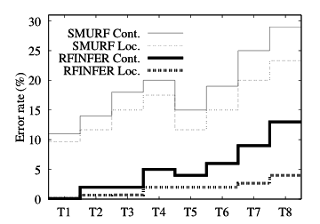
Evaluation of a Lab RFID Deployment
Trace settings:
T1: RR=0.85, OR=0.25
T2: RR=0.85, OR=0.5
T3: RR=0.7, OR=0.25
T4: RR=0.7, OR=0.5
T5 to T8 extend T1 to T4 with 3 items moved across cases, 1 item removed
Improved SMURF (window-based temporal smoothing) w. containment inference and change detection
Our algorithm: (1) Location error rates are low. (2) Containment error rates are low with stable containment. (3) Containment changes cause more errors, especially given more noise (lower rate rates or higher overlap rates).
SMURF: much more errors. Simple temporal smoothing has missed opportunities.

Slide 19
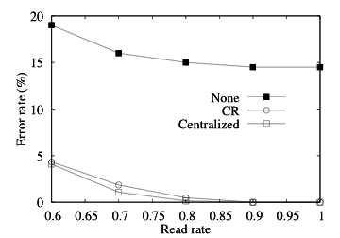
Results for Distributed Inference w. State Migration
Experiment setting: 10 warehouses, each with up to 150,000 items, totaling 1.5 million items
Compared algorithms: State Migration (CR), No State Migration (none), and Centralized
bytes | Centralized | None | CR
RR=0.6 | 125,895,500 | 0 | 225,890
RR=0.7 | 145,858,950 | 0 | 223,790
RR=0.8 | 166,746,235 | 0 | 225,890
RR=0.9 | 187,589,810 | 0 | 225,890
The naïve method with no state-transfer has a high error rate.
The centralized method incurs a huge amount of data to be transferred.
Our method (CR) performs close to the centralized method in accuracy but with x830 reduction in communication cost.

Slide 20
Results for Distributed Query Processing
Q1: reports the frozen food that has been placed outside a cooling box for 3 hours.
Q2: reports the frozen food that has been exposed to temperature over 10 degrees for 10 hours.
 |  | RR=0.6 | RR=0.7 | RR=0.8 | RR=0.9
Q1 | F-measure(%) | 89.2 | 94 | 95.1 | 96
 | State w/o sharing (bytes) | 65,500 | 66,000 | 67,037 | 67,000
 | State w sharing (bytes) | 6,986 | 5,737 | 5,589 | 5,156
Q2 | F-measure(%) | 93.5 | 96.1 | 97.3 | 97.5
 | State w/o sharing (bytes) | 80,248 | 85,510 | 87,029 | 87,000
 | State w sharing (bytes) | 7,296 | 6,108 | 5,341 | 5,273
The overall accuracy (F-measure) of query results is high (>89%).
Query state sharing yields up to 10x reduction in query state size.
The accuracy and query state reduction ratio of Q1 are lower than those of Q2, because Q1 combines location and containment while Q2 uses only inferred location.

Slide 21
Summary and Future Work
Summary:
  Novel inference techniques that provide accurate estimates of object locations and containment relationships in noisy, dynamic environments.
  Distributed inference and query processing techniques that minimize the computation state transferred.
  Our experimental results demonstrated the accuracy, efficiency, and scalability of our techniques, and superiority over existing methods.
Future work:
  Exploit local tag memory for distributed inference, such as utilizing aggregate tag memory and fault tolerance.
  Extend work to probabilistic query processing.
  Explore smoothing over object (entity) relations in other data cleaning problems.

Slide 22
Thank You!

