Slide 1
Serializable Snapshot Isolation for Replicated Databases in High-Update Scenarios
Hyungsoo Jung (presenter) Hyuck Han* Alan Fekete Uwe Röhm
The University of Sydney
{firstname.lastname}@sydney.edu.au
*Seoul National University
*hhyuck@dcslab.snu.ac.kr

Slide 2








Data Replication in the 21st Century
Database Replication
You could use locking
for strong consistency ...
Simple replication does not guarantee “strong consistency”
Data Replication
with Relaxed Consistency

Slide 3
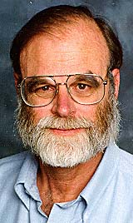
“The Dangers of Replication …”
[Jim Gray et al., SIGMOD’96]
“Update anywhere-anytime-anyway transactional replication has unstable behaviors…”
So use Snapshot Isolation (SI) in each replica, then build replicated snapshot DBs.
This is especially true to all the then-known locking-based replication.

Slide 4
Snapshot Isolation
[Berenson et al., SIGMOD’95]
Snapshot Isolation (SI):
  Transactions read a consistent snapshot of data
    DBMS maintains multiple versions of data items to avoid locking for reads
  Only one transaction among many updating the same data concurrently can commit by the First-Committer-Wins (FCW) rule.
  1-copy SI is for replicated databases

Slide 5


Problems in Replicated Snapshot DB
Replica 1
Update anywhere-anytime-anyway transactional replication
DB under SI
DB under SI
Update Propagation
DB under SI
Users
Replica N
Transactions may
see different values
Replicated DB under Snapshot Isolation does not prevent data corruption and violation of integrity constraints (ICs).
1-copy serializability (1-copy SR) is the only condition that preserves the truth of all ICs.

Slide 6
Anomaly under 1-copy SI
Doctor | Shift | Status
Jones | 31 AUG | on duty
Smith | 31 AUG | on duty
Replicated
Doctor | Shift | Status
Jones | 31 AUG | on duty
Smith | 31 AUG | on duty
Replica A
Doctor | Shift | Status
Jones | 31 AUG | on duty
Smith | 31 AUG | on duty
Replicated
Replica B
Example by courtesy of Cahill et al. [SIGMOD’08]

Slide 7
Anomaly under 1-copy SI
Doctor | Shift | Status
Jones | 31 AUG | on duty
Smith | 31 AUG | on duty
T1 (Update Jones)
Integrity Constraint
- One doctor must be “on duty” in every shift.
Replica A
Doctor | Shift | Status
Jones | 31 AUG | on duty
Smith | 31 AUG | on duty
T2 (Update Smith)
Replica B
Example by courtesy of Cahill et al. [SIGMOD’08]

Slide 8
Anomaly under 1-copy SI
Doctor | Shift | Status
Jones | 31 AUG | reserve
Smith | 31 AUG | on duty
Commit T1
Integrity Constraint
- One doctor must be “on duty” in every shift.
Replica A
Doctor | Shift | Status
Jones | 31 AUG | on duty
Smith | 31 AUG | reserve
Commit T2
Replica B
Example by courtesy of Cahill et al. [SIGMOD’08]

Slide 9
Anomaly under 1-copy SI
Doctor | Shift | Status
Jones | 31 AUG | reserve
Smith | 31 AUG | reserve
Violation of IC
Integrity Constraint
- One doctor must be “on duty” in every shift.
Replica A
Doctor | Shift | Status
Jones | 31 AUG | reserve
Smith | 31 AUG | reserve
Replica B
Example by courtesy of Cahill et al. [SIGMOD’08]

Slide 10
Why 1-Copy SI ≠ 1-Copy SR ?
Under Snapshot Isolation:
  Transactions don’t see concurrent writes
    This causes some interleaving anomalies, which makes (1-copy) SI not equivalent to (1-copy) serializable execution.
T1
r1(Jones=“on duty”, Smith=“on duty”)w1(Jones=“reserve”)
Write-Skew
T2
r2(Jones=“on duty”, Smith=“on duty”)w2(Smith=“reserve”)

Slide 11
The Goal of Concurrency Control
Serializable
Isolation
(2PL)
Serializable
Something
(possible???)
Isolation Level
Snapshot Isolation
Performance

Slide 12
Our Contributions
Update anywhere-anytime-anyway transactional replication
1-copy SR over SI replicas
New theorem & Prototype implementation
Optimized for update-heavy workloads

Slide 13
Our Approach
New algorithm for 1-copy SR
  Runtime analysis of the transaction serialization graph, considering consecutive rw-edges
  New sufficient condition for 1-copy SR
Core Ideas:
  Detect read-write conflicts at runtime, i.e., commit time.
  Abort transactions with a certain pattern of consecutive rw-edges
  Retrieving complete rw-dependency information without propagating entire readsets.

Slide 14
Previous Work for 1-copy SR
[Bornea et al., ICDE2011]
 | Bornea et al. | This Work
Architecture | Middleware | Kernel
Readset Extraction | SQL parsing | Kernel interception
Certification | ww-conflict 1 rw-edge | ww-conflict 2 rw-edges
Optimized for | Read mostly | Update heavy

Slide 15


Descending Structure
There are three transactions Tp, Tf and Tt with the following relationships:
  Tp Tf and Tf Tt
  lsv(Tf) lsv(Tp) && lsv(Tt) lsv(Tp)
lsv is a number we keep for each transaction: largest timestamp a transaction reads from
Descending Structure
lsv(Tp)
Tp
r1(x0)
lsv(Tf)
Tf
r2(y0)w2(x0)
Tt
w3(y0)
lsv(Tt)

Slide 16
Main Theorem for 1-copy SR
Central Theorem: Let h be a history over a set of transactions obeying the following conditions
  1-copy SI
  No descending structure
Then h is 1-copy serializable.

Slide 17
Concurrency Control Algorithm
Replicated Serializable Snapshot Isolation (RSSI)
  ww-conflicts are handled by 1-copy SI.
  When certification detects a “descending structure”, we abort whichever completes last among the three transactions.
Abort T_{f}
lsv(Tp1)
Tp
r1(x0)
lsv(Tf)
Tf
r2(y0)w2(x0)
lsv(Tt)
Tt
w3(y0)

Slide 18
Technical Challenges
The management of readset information and lsv-timestamps is pivotal to certification.
We developed a global dependency checking protocol (GDCP) on top of LCR broadcast protocol [Guerraoui et al., ACM TOCS2010].
  GDCP mainly performs two tasks at the same time:
    Total order generation using existing LCR protocol.
    Exchanging rw-dependency information without sending the entire readset.

Slide 19
In Each Participating Node
Client
Implementation is
based on Postgres-RSI
Query Processing
Certifier
Replication
Manager
To other replicas
Storage
readset & writeset
extraction

Slide 20

Propagating rw-dependency Information
WS1
RS1
WS1
rw-edges1
Update
Check rw-edges
writeset2
readset2

Slide 21
Discussion
RSSI has overhead in read mostly scenarios due to full certification on all types of transactions.
RSSI still has some false positives:
lsv(Tp)
Tp
r1(x0)
Abort Tt
lsv(Tf)
Tf
r2(y0)w2(x0)
lsv(Tt)
Tt
w3(y0)

Slide 22
Experimental Setup
Comparing
  RSSI (Postgres-RSSI) : our proposal (1SR)
  CP-ROO – conflict-management of Bornea et al. with our architecture (1SR)
  RSI : certification algorithm of Lin et al. with our architecture
    1-SI, but not 1SR !!
Synthetic micro-benchmark
  Update transactions read from a table, update records in a different table.
  Read-only transactions read from a table.
TPC-C++ [Cahill et al.,TODS2009]
  No evident difference in performance between the three algorithms (details in the paper)

Slide 23
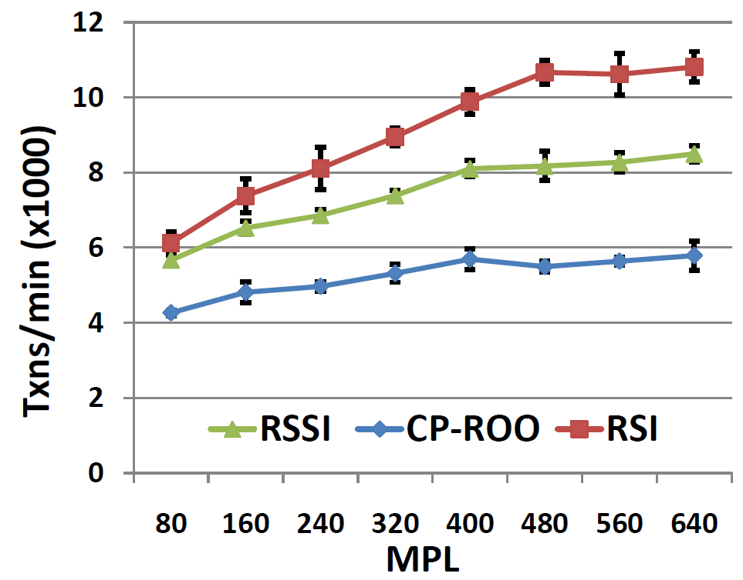
Micro-benchmark, 75%Updates:
Throughput (8 Replicas)

Slide 24
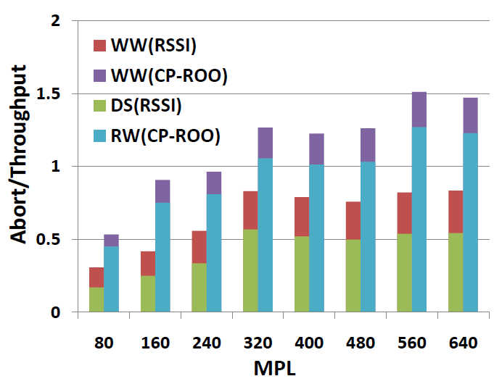
Micro-benchmark, 75%Updates:
Throughput & Aborts (8 Replicas)

Slide 25
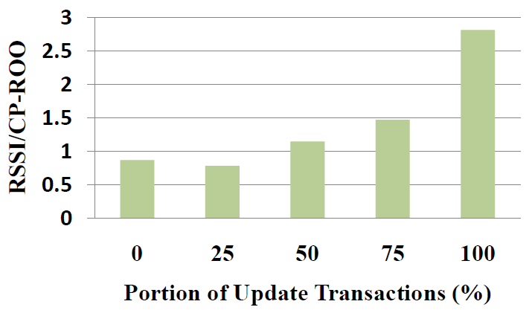
Micro-benchmark: Performance Spectrum
(8 Replicas, MPL=640)

Slide 26
Summary
Update anywhere-anytime-anyway transactional replication
1 SR over SI replicas
New theorem & Prototype implementation
Optimized for update heavy
Thank You
Q&A

