Slide 1
Active Complex Event Processing
PVLDB 2011, Seattle, USA
Di Wang
Elke A. Rundensteiner
Worcester Polytechnic Institute
Richard Ellison III
Univ. of Massachusetts Medical School
This work is supported by NSF grant IIS-1018443 and
UMMS-WPI CCTS Collaborative grant

Slide 2
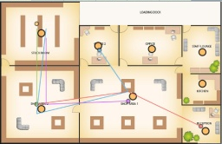





Complex Event Processing (CEP)
  Technology for high-throughput, low-latency processing of event streams
Sensor based monitoring
Complex Event Processing Engine
Output Applications
Click stream analysis
Event patterns
Algorithmic trading
Notes:
CEP has been used in may applications, where
event streams are observed in many applications, …
CEP has the expertise of detecting complex event patterns.
Complex patterns of events often capture exceptions, threats
or opportunities occurring across application space and time.
Complex Event Processing (CEP) technology has thus increasingly
gained popularity for efficiently detecting such event
patterns in real-time

Slide 3


Problem: Reacting to Event Streams
Motivating application: HyReminder
  real-time infection control system at hospital
CEP ENGINE
Queries:
SEQ(exit, !sanitize, enter)
w/i 45 sec
…
Hygiene violation
Reactions:
change the worker’s status
sanitize
Need to react to opportunities / risks
detected
exit
enter
hygiene status
hygiene status
Notes:
As shown in Figure 1, every HCW wears
a RFID badge which has a three-color light for indicating
his (hygiene) status: \safe", \warning" or \violation". Pat-
tern queries continuously monitor each HCW's behaviors
observed by sensors. The status of each HCW is continu-
ously changed upon detecting certain event patterns. For ex-
ample, a detected hygiene violation pattern will change the
HCW's status to \violation" (henceforth his badge light).
In order to urge a HCW to perform precautions immedi-
ately upon the detected hygiene violation, it is critical for us
to support such real-time reactions for the pattern queries.
Furthermore, the status of each HCW is also used as a con-
dition by pattern queries, e.g., a pattern query may only
monitor HCWs in \safe" status. Clearly the reactions for
queries that update HCWs' status will aect query results
in turn. It is absolutely vital to control such concurrent
updates and accesses so as to assure the correct execution
logic. Otherwise we risk for a potentially highly contagious
disease to be transmitted to vulnerable patients - thus in-
creasing patient suering and even causing deaths.

Slide 4
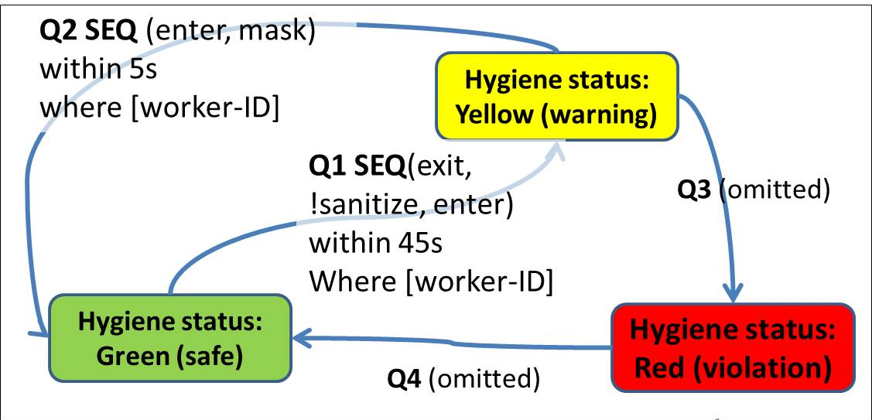
New Requirements
To specify the reactions of queries
To support real-time interactions between queries and the reactions of queries
Notes:
Let me explain the requirement in further depth
Healthcare-associated infec-
tions hit 1.7 million people a year in the United States, caus-
ing an estimated 99,000 deaths [18]. The HyReminder sys-
tem is a hospital infection control system developed by WPI
and UMass Medical School to continuously track healthcare
workers (HCWs) for hygiene compliance (for example sani-
tizing hands and wearing masks), and to remind HCWs to
perform hygiene precautions - thus preventing the spread of
infections [11]. As shown in Figure 1, every HCW wears
a RFID badge which has a three-color light for indicating
his (hygiene) status: \safe", \warning" or \violation". Pat-
tern queries continuously monitor each HCW's behaviors
observed by sensors. The status of each HCW is continu-
ously changed upon detecting certain event patterns. For ex-
ample, a detected hygiene violation pattern will change the
HCW's status to \violation" (henceforth his badge light).
In order to urge a HCW to perform precautions immedi-
ately upon the detected hygiene violation, it is critical for us
to support such real-time reactions for the pattern queries.
Furthermore, the status of each HCW is also used as a con-
dition by pattern queries, e.g., a pattern query may only
monitor HCWs in \safe" status. Clearly the reactions for
queries that update HCWs' status will aect query results
in turn. It is absolutely vital to control such concurrent
updates and accesses so as to assure the correct execution
logic. Otherwise we risk for a potentially highly contagious
disease to be transmitted to vulnerable patients - thus in-
creasing patient suering and even causing deaths.

Slide 5

How to Meet the Requirements
State-of-the-art
  Only support “read-only” pattern queries
  (Cayuga [1], SASE [2], Zstream[3], etc.)
  Only “side-effect-free“ reactions for pattern detections (Siemens [4])
Our proposal:
Active Complex Event Processing (ACEP)
  Embedding active rule support within CEP
  allow to specify a pattern query's dynamic condition and real-time actions
[1] A. Demers et al. Cayuga: A general purpose event monitoring system. CIDR 2007
[2] E. Wu et al. High-performance complex event processing over stream. SIGMOD 2006
[3] Y. Mei et al. Zstream: A cost-based query processor for adaptively detecting composite events. SIGMOD’09
[4] F. Wang, S. Liu, and P. Liu. Complex rd event processing. VLDB Journal, 2009
Notes:
Unfortunately, cur-
rent CEP systems support \read-only" query processing.
Pattern queries only contain in-place conditions, i.e., the
query qualication is either based on the attributes of events
matched in the input stream [8, 12, 16, 17] or on static infor-
mation pre-loaded once yet not updated during query execu-
Moreover, reactions for event detections are
limited to \side-eect-free" actions like sending a message
or logging events that do not aect the event detection in
turn [22].

Slide 6
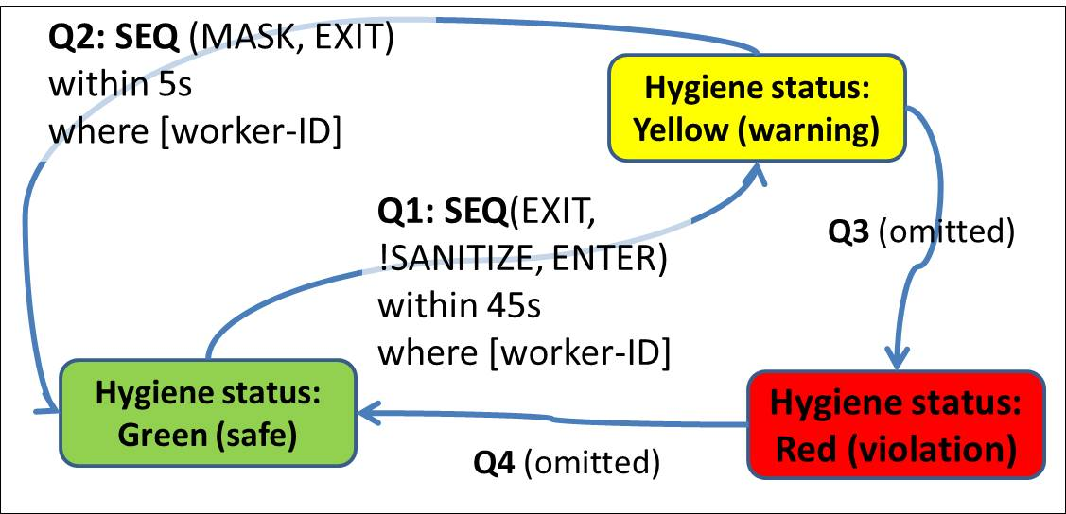
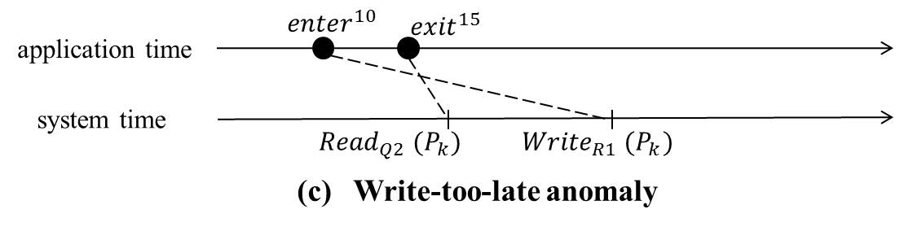
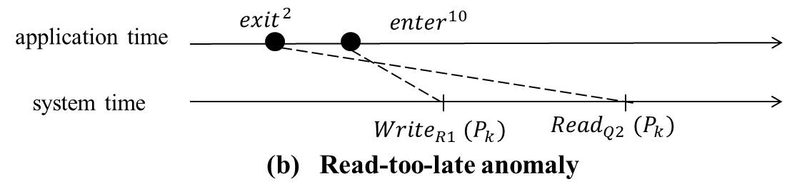
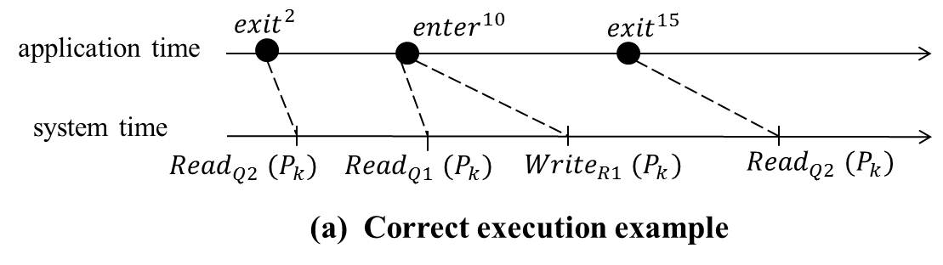
Challenges
Interactions among continuous queries and rules
  Problems of “push-based” stream execution
Notes:
First briefly describe what is continuous queries
A critical technical challenge is to handle the real-time
mutual effects between queries and reactions for queries in
the high-volume stream execution. In ACEP we abstract
such effects as interactions among continuous queries and
active rules.
We illustrate the problems with three examples
drawn from the HyReminder application1
In the commonly-employed push-based stream execution
paradigm [4, 7, 8, 12, 16, 17], new events are evaluated
by continuous queries immediately upon event arrival with-
out any safeguard mechanism to synchronize the concurrent
accesses and updates during stream execution.
Since continuous queries may vary in their complexities and event
consumption, they may exhibit different processing delays.
As a result, events with different timestamps tend to co-exist
and be simultaneously executed in the system.
Using this push-based execution for pattern queries and reactions for
queries (represented as active rules) may raise unexpected
anomalies..

Slide 7

Introducing Stream Transactions
To handle concurrent access and update …
Transaction processing …
“Database transaction" –
a sequence of one-time
data manipulation operations
on stored data
In stream environments,
queries are continuously
executed on
infinite data streams
Be the first to introduce transaction in the stream context
Stream transaction scheduling algorithms
Notes:
To address the challenge…
This implies that we can-
not \nish" the current query as a nite-scoped operation
before processing another query. In short, the concept of a
transaction has not been established for stream processing.
In this work, we ll this void by introducing the notion of a
transaction in the stream context.

Slide 8
Outline
Introduction
  Need for supporting active rules in CEP
  Identifying stream-concurrency problem
Active CEP Model
Stream-Transaction
  New Model
  Scheduling Algorithms
Experimental Results
Conclusion
Notes:
So, I just have described our motivating application and the major requreimetns derived from the application.
Now, to allow the specification of a pattern query’s real-time action, let’s first look at the ACEP model
1Named after the concept of “active databases” which refers to static
relational databases extended with rules

Slide 9


Active CEP Data Model
Semantic store
  Shard store ($P$)
  $$p=(t_{1}, t_{2}, …, t_{m})$$
Event streams
  input stream ($I$)
  $${i=(e}_{1},e_{2}, …, e_{n})$$
  output stream ($O$)
  ${o=(ce}_{1},{ce}_{2}, …, {ce}_{n})$
event:
(object-ID, sensor-ID, timestamp)
Input stream
Hygiene status
Semantic information binding
Shared store
event:
Behavior (worker-ID, location, timestamp)
CEP pattern matching
Output stream
Active rule
execution
Notes:
In real-world event-based applications,
the raw event data is augmented with semantically richer information.
For example, a typical RFID reading is simply a triple
(object-ID, sensor-ID, timestamp). In the HyReminder application,
the object-ID is bound with the HCW identification and
the sensor-ID is interpreted based on the location of sensors
and the physical layout of the hospital. Semantic information
regarding the application hence needs to be maintained in
the system - referred to shared store through this paper. In
the ACEP system, a shared store can be both readable and
updatable by multiple queries and active rules.
Using such shared store is crucial to express business logic
in applications - the pattern queries can read the shared store,
while the action of active rules (introduced below) can update
the shared store, both in real-time, hence the newly updated
store will affect the succesive query execution in turn.

Slide 10
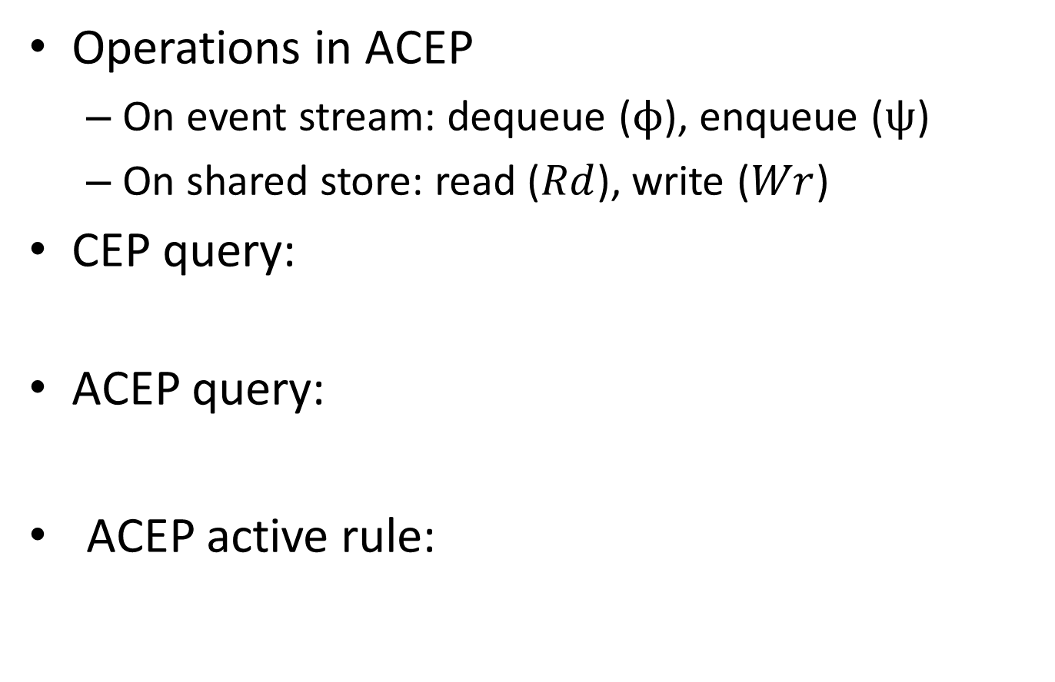
Active CEP Query/Rule Model
Operations in ACEP
  On event stream: dequeue ($ϕ$), enqueue ($ψ$)
  On shared store: read ($Rd$), write ($Wr$)
CEP query:
ACEP query:
ACEP active rule:
Notes:
A CEP
query, q, is dened as a function that takes as argument an
instance of on the input stream, i.e., an arrival of input
event, and returns an instance of on the input stream and
zero or more instances of on the output stream.
An
ACEP query can be viewed as a combination of shared store
accesses (e.g., to check the HCW's hygiene status) and a
CEP query (e.g., to detect the pattern SEQ(EXIT, !SANITIZE,
ENTER)).
An ACEP active
rule is triggered by the output of an ACEP query. The
condition of an active rule is a logical test that, if evaluates
to true, causes the action of the active rule to be carried out.
Similar to the qualication of a pattern query (Appendix B),
the logical test can be based on the attributes of the trigger-
ing event or on the content of the shared store. The action
of an active rule supported in the current ACEP model is
the Write operation on the shared store. Such active rules
are of great use and ubiquitous in ACEP applications as
demonstrated by our motivating examples. Namely, pat-
tern queries read the shared store, while the active rules
may write the shared store, both in real-time. Hence the
newly updated value of the shared store will in turn aect
subsequent query execution.

Slide 11
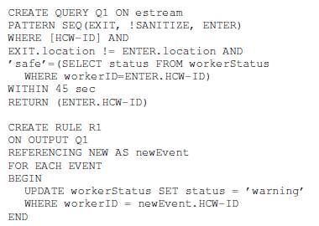
ACEP Rule Example
Sequence pattern query
Access the shared store
Triggered by query output
Update the shared store

Slide 12
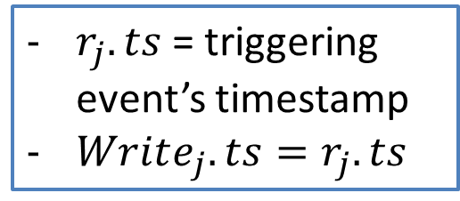
Notion of Correctness
Features of simultaneous execution of queries and active rules in stream context:
  When triggering event occurs, rule action should take effect instantaneously
  Each Read has implicit timestamp
  Do not tolerate the undo or redo of any externally visible output or action
$r_{j}.ts$ = triggering event’s timestamp
$Write_{j}.ts=r_{j}.ts$
Each operation on shared store has app. based timestamp
Correct execution should correspond to operations’ app. timestamps
Notes:
we introduce our notion of correctness for
the simultaneous execution of pattern queries and active
rules in the stream context.
To define the correctness, let us first look at the distinguishing features of ….
Distinguishing Features of our notion of application
correctness include: First, it targets ACEP applications,
such as the motivating healthcare system, which apply real-
time eect to the external world, and thus do not tolerate
the undo or redo of any externally visible output or action.
Second, in our target applications, a Write operation repre-
sents a real-time eect, e.g., changing a HCW's badge color.
Hence the order of executing Writes must conrm to their
timestamp order. In our formal denition below, let Writei,
Writej , Readk and Readl be operations on a shared table.

Slide 13
Outline
Introduction
  Need for supporting active rules in CEP
  Identifying stream-concurrency problem
Active CEP Model
Stream-Transaction
  New Model
  Scheduling Algorithms
Experimental Results
Conclusion
Notes:
So, I just have described our motivating application and the major requreimetns derived from the application.
Now, to allow the specification of a pattern query’s real-time action, let’s first look at the ACEP model
1Named after the concept of “active databases” which refers to static
relational databases extended with rules

Slide 14




Stream Transaction Model
Definition: A stream-transaction is a sequence of ACEP system state changes that are triggered by a single input event
  Very different from traditional transaction
  Stream-ACID properties – see paper
Dequeue, Enqueue, Read,
Write
$${e_{i}}^{ts}$$
App time
… …
Sys time
${{Read}_{1}}^{ts}{(P}_{1})$/ ${{Write}_{1}}^{ts}{(P}_{1})$
… …
${{Read}_{i}}^{ts}{(P}_{n})$/ ${{Write}_{i}}^{ts}{(P}_{n})$
s-transaction for ${e_{i}}^{ts}$
Notes:
Traditionally a database transaction cor-
responds to a user program that is invoked when a user ex-
plicitly requests so, while our stream query processing is trig-
gered by incoming streaming events. Moreover, a database
transaction corresponds to the execution of a sequence of
one-time queries [2, 19], while in our stream system the pat-
tern queries are continuously running. Therefore we must
rst dene the notion of a transaction in the stream context.
This definition also accords to our intuition, right? All these operations should happen as a whole or none.

Slide 15
S-Transaction Scheduling Algorithms
Goals
  What is an intuitive solution?
  Can we adapt conventional transaction algorithms?
  How to achieve high system responsiveness?
Proposed Schedulers
  Single-event-initiated
  Strict-two-phase-lock
  Low-water-mark
Notes:
Assumptions: in-order

Slide 16










S-Transaction Scheduling Algorithms (Cont.)
Keep in mind the correctness: execution should correspond to operations’ app. timestamps
  Single-event-initiated
  take a single input event at a time and to execute all affected queries and rules to converge
  Pros: easy to adopt Cons: causing large delay
Strict-two-phase-lock
  Mimicking classical S2PL for s-transactions
$${wash}^{2}$$
$${enter}^{10}$$
$${exit}^{15}$$
$P_{k}$: HCW007’s status
application time
1 | warning
2 | safe
system time
$${{Write}_{R2}}^{ }{(P}_{k})$$
$${{Read}_{Q1}}^{ }{(P}_{k})$$
$${{Read}_{Q1}}^{ }{(P}_{k})$$
$$T_{1}$$
$$T_{2}$$
Notes:
The first solution, called Single-
Event-Initiated (SEI) scheduler, requires minimum change
of an existing CEP engine and hence is easy to use.
Here we assume that
we initially assume events are fed into
our system in strictly increasing application time order.
Later we relax this assumption and extend the schedulers
to function also over disordered streams in Appendix F.
Our current ACEP mo-
del uses the no-cascading-trigger assumption. That is,
rules are triggered by the stream output of queries while
rules do not produce any stream output. Hence cycles
in triggering will not arise. We also assume every single
s-transaction is nite. Consequently, all s-transactions in
ACEP are guaranteed to terminate. This model, while
simple, has practical utility as demonstrated by our moti-
vating applications. Similarly, most DBMSs in the litera-
ture [6, 10] or in practice (e.g., Oracle) either require nite
rule specication or they place a hard-coded threshold on
the number of cascading trigger calls allowed.
The second solution adapts a general-purpose concurrency control
mechanism, namely the Strict Two-phase Locking (S2PL
[2]), to the ACEP context, demonstrating that our proposed
notion of s-transactions allows us to leverage existing con-
currency control approaches.
Mimicking the classical S2PL [2], our
S2PL inserts locks into an s-transaction ahead of all query
and rule processing (known as Phase I).
So we need to analyze continuous queries and rules registered in the system and
determine what locks are possibly needed.
All locks applied by
an s-transaction Ti are released after the s-transaction has
successfully ended (known as Phase II).

Slide 17

Low-Water-Mark Scheduler
Design
  Correctness is about application time based constraints → timestamp an s-transaction based on the application time of triggering input event
  Maintain multi-versions of each shared table
  Integrate with locking → key idea: consistently render synchronization order of both locking and time-stamping
Directly apply MVCC?
No… fail to achieve correctness
Abort is not acceptable
Restarting transaction with newer timestamp leads to erroneous result
Notes:
in contrast to the mechanism employed by classical Multi-
version Concurrency Control protocol (MVCC) or Time-
stamp Concurrency Control (TSCC). The later generates
timestamps using the system counter in a rst-come-rst-
served manner [2, 19].
First, abort of a
transaction, representing an undo of externally visible out-
put or action, is not acceptable in ACEP applications, as
stated in Section 4.1. Second, restarting a transaction with
a dierent timestamp is equally unacceptable. In LWM, an
s-transaction's timestamp reects the application time when
its issued operations should take eect. Hence if a restart
were to occur, the newly set timestamp would lead the s-
transaction to read and write the wrong version thus incur
erroneous results.

Slide 18




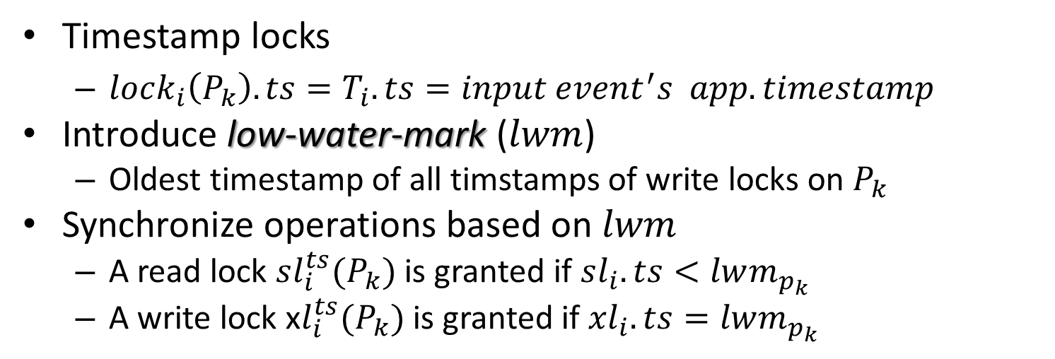









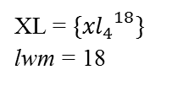








Low-Water-Mark Scheduler (Cont.)
Timestamp locks
  $lock_{i}\left(P_{k}\right).ts=T_{i}.ts=input event^{′}s app. timestamp$
Introduce low-water-mark ($lwm$)
  Oldest timestamp of all timstamps of write locks on $P_{k}$
Synchronize operations based on $lwm$
  A read lock $sl_{i}^{ts}(P_{k})$ is granted if $sl_{i}.ts<lwm_{p_{k }}$
  A write lock x$l_{i}^{ts}(P_{k})$ is granted if ${xl}_{i}.ts=lwm_{p_{k }}$
application time
$${exit}^{2}$$
$${enter}^{10}$$
$${exit}^{15}$$
$${wash}^{18}$$
system time
$${{Read}_{Q1}}^{ }{(P}_{k})$$
$${{Read}_{Q1}}^{ }{(P}_{k})$$
$${{Write}_{R1}}^{ }{(P}_{k})$$
$${{Read}_{Q2}}^{ }{(P}_{k})$$
$${{Write}_{R2}}^{ }{(P}_{k})$$
$$T_{1}$$
$$T_{2}$$
$$T_{3}$$
$$T_{4}$$
HCW007’s status
HCW007’s status
$${{sl}_{1}}_{}^{2}$$
1 | safe
$${{sl}_{i}}_{}^{6}$$
1 | safe
10 | warning
(a) Before $T_{2}$ ends
$${{sl}_{3}}_{}^{15}$$
(b) After $T_{2}$ ends
$${{sl}_{3}}_{}^{15}$$
XL = $\{{{xl}_{2}}_{}^{10},{{xl}_{4}}_{}^{18}\}$
lwm = 10
XL = $\{{{xl}_{4}}_{}^{18}\}$
lwm = 18
Notes:
scheduling strategy
(LWM) customized for stream-transaction execution. The
pseudocode of LWM and a formal proof of its correctness
are in Appendix E.

Slide 19
Experiment Setup
Implementation
    within HP CHAOS CEP engine
Data: real-world workload
    from Univ. of Massachusetts Memorial Hospital
Pattern queries and active rules
  Referring to the hand hygiene regulations [5]
    model sequence of HCW behaviors using pattern queries
    model HCW's hygiene performance with three status, maintain as shared store
    model HCW status transitions, i.e., a sequence of behaviors leading HCW from one status to another, using active rules
[5] J. M. Boyce and D. Pittet. Guideline for hand hygiene in healthcare settings. MMWR Recomm Rep., 2002
Notes:
Referring to the hand hygiene regulations applied in US
hospitals [3], we have created ACEP queries and active rules
using the following methodology:

Slide 20
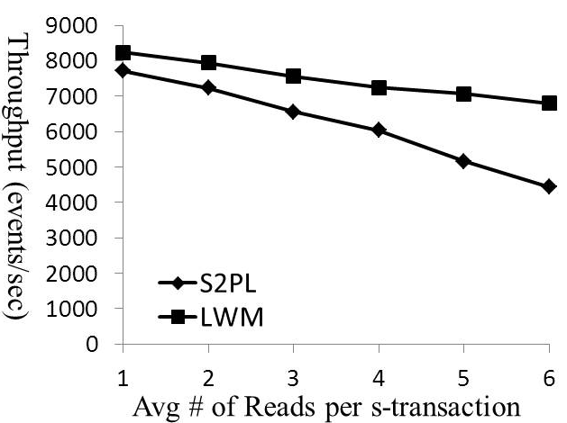
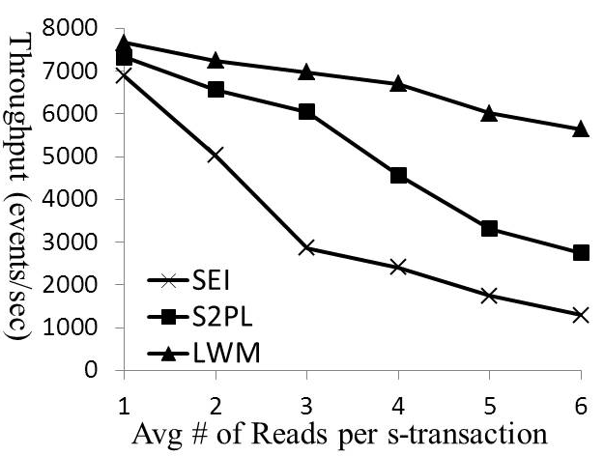
Experimental Results - 1
Vary # of Reads vs. Throughput
  LWM is capable to grant more locks concurrently
Lock level = tuple (on each individual HCW’s status)
Lock level = table (on all HCWs’ status)
Notes:
We
evaluate the throughput while varying the average number
of Read operations per s-transaction (readN) from 1 to 6.
The average number of Write operations per s-transaction
(writeN) is set to 0.25 by selecting the corresponding query-
rule pairs from the pool. S2PL and LWM perform locks at
tuple level. Figure 5 shows that LWM scales more gracefully
than S2PL. This is mainly because LWM is capable to grant
signicantly more locks concurrently.

Slide 21
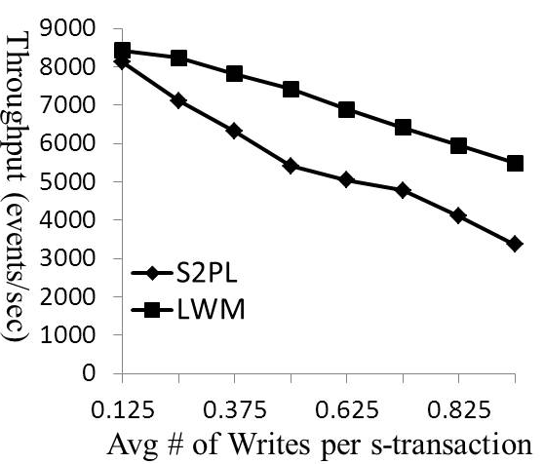
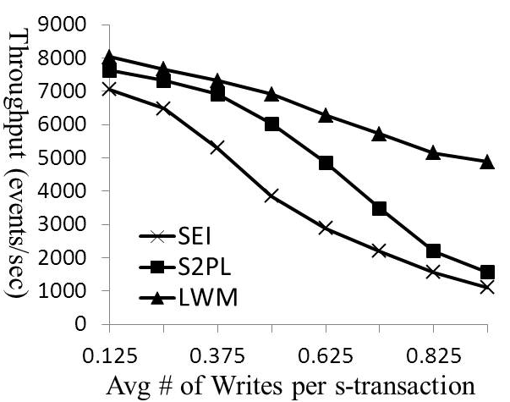
Experimental Results - 2
Vary # of Writes vs. Throughput
  LWM still wins
  When WriteN=1, S2PL performs similar to SEI
Lock level = tuple (on each individual HCW’s status)
Lock level = table (on all HCWs’ status)
Notes:
We
here consider the throughput while varying the average num-
ber of Write operations per s-transaction (writeN) from
0.125 to 1.0. The average Reads per s-transaction (readN) is
set to 1. The lock granularity is set to be at tuple level. Fig-
ure 7 shows that the throughputs drop as writeN increases.
One main reason is that the average processing complexity
per s-transaction rises. The increasing cost also comes from
more write-locks being requested. LWM beats S2PL due to
allowing more overlaps among s-transactions.
Next we set the lock granularity to be at table level. As
per Figure 8, the throughput of S2PL and LWM become
more sensitive to writeN compared to Figure 7. Especially
when writeN = 1, S2PL performs similar to SEI, because
on average one table-level write lock is held for every s-
transaction and S2PL in fact serializes every s-transaction
while synchronizing very few (if any) concurrent executions.

Slide 22
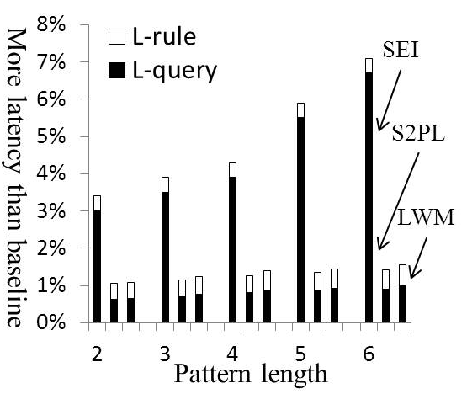
Experimental Results -3
Overhead: Varying Pattern Length vs. Latency
  SEI incurs 3x to 6x larger combined latency than S2PL and 3x to 5x larger than LWM
Lock level = tuple (on each individual HCW’s status)
More experiments in the paper…

Slide 23
Conclusion
Proposed ACEP for supporting active rules - that may in turn affect continuous pattern query results
Identify the problem of concurrency control in stream execution, the first attempt of introducing transactional concepts into stream environments
Design stream-transaction scheduling algorithms that achieve high responsiveness without compromising correctness
Apply ACEP to real-world application and experimentally demonstrate its effectiveness
Notes:
While we have chosen the active rule model as foundation
of our solution, alternate formalizations to express the re-
actions for pattern queries are also possible. By describing
these alternate models below, we show that no matter which
computational model is employed, the issues of concurrent
accesses and updates during stream execution would still
need to be tackled. For this, our core innovation, including
the correctness notion, stream-transactions and the schedul-
ing strategies (Sections 4, 5) could continue to be an elegant
solution for executing other models.

Slide 24

wangdi@cs.wpi.edu
http://davis.wpi.edu:8180/DSRG/

